Slide 1
Quiz Society
Week 3

Slide 2
Rules
Get into teams of 1-4 people
Have a piece of paper, a writing implement, and a team name prepared
There will be 5 rounds, with 6 questions per round
3 minutes per round
The team with the most points at the end wins

Slide 3
ROUND 1
CAPITAL CITIES
BY ANAGRAMS

Slide 4
NAME THE CAPITAL CITY FROM ITS ANAGRAM
MAIL
LENTIL GOWN
CAPTAIN YAM
ANIMAL
EGO SPRAIN
SMART DAME

Slide 5
ROUND 2
FONTS

Slide 6
RISK IT
FOR
THE BISCUITS

Slide 7
RULES
Earn bonus points by getting multiple answers correct
2 correct answers – 1 Bonus Point
4 correct answers – 2 Bonus Points
6 correct answers – 3 Bonus Points
HOWEVER
Get 1 question wrong, and score 0 points for the entire round
Leave an answer blank, and it is not counted as wrong

Slide 8
DOES THE WORD MATCH THE FONT?
Calibri(Body)
Aparajita
Courier New
Times New Roman
Arial
6. Papyrus

Slide 9
ROUND 3
HISTORY
AMERICAN CIVIL WAR

Slide 10
WHAT YEAR DID IT START IN?
WHAT YEAR DID IT END IN?
WHO WAS THE PRESIDENT OF THE UNITED STATES DURING THE WAR?
WHO WAS THE PRESIDENT OF THE CONFEDERATE STATES?
WHAT WAS THE FIRST BATTLE?
HOW DID THE FIRST PERSON DIE IN THE WAR?

Slide 11
ROUND 4
MOVIES
LORD OF THE RINGS

Slide 12
HOW MANY FELLOWSHIP OF THE RINGS ARE THERE?
WHAT COUNTRY IS LORD OF THE RINGS FILMED IN?
WHICH ACTOR PLAYS BOROMIR?
WHAT IS THE LAST LINE IN LORD OF THE RINGS?
WHAT IS THE NAME OF THE INN THAT FRODO BAGGINS WAS MEANT TO MEET GANDALF IN?
WHAT YEAR WAS THE FIRST LORD OF THE RINGS FILM?

Slide 13
ROUND 5
VIDEO GAMES
BY MEME

Slide 14
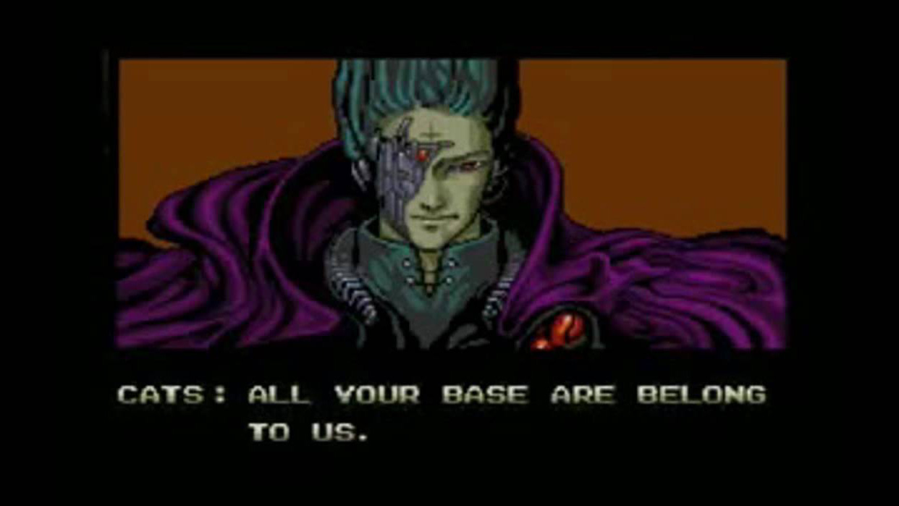
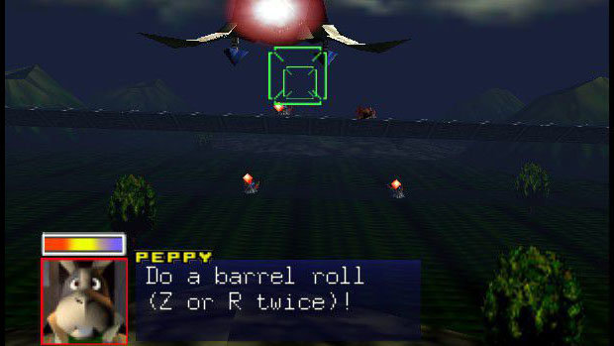


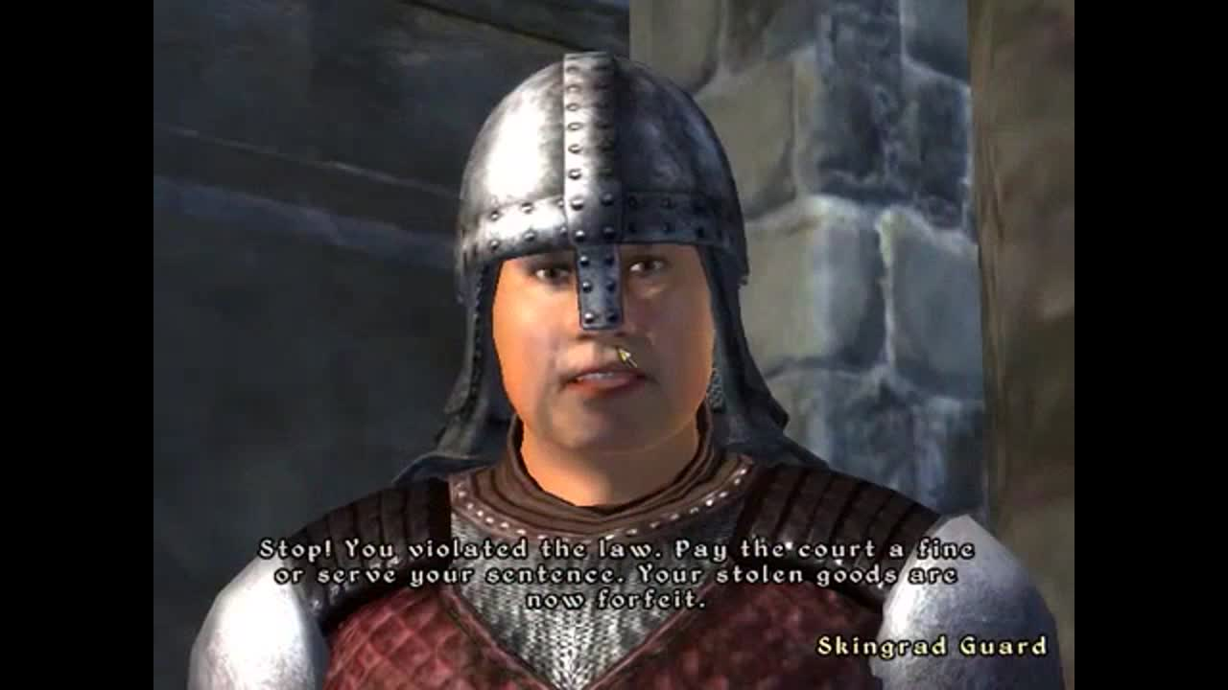

NAME THE GAME THAT THESE MEMES ORIGINATE FROM
1
2
3
4
5
6

Slide 15
SWAP YOUR PAPERS, IT’S ANSWER TIME
BONUS ROUND

Slide 16
WHAT’S NEXT?
MISSING LINK

Slide 17
WHAT COMES NEXT?
ARIA LAND MANIA

Slide 18
SWAP YOUR PAPERS, IT’S ANSWER TIME

Slide 19
ROUND 1
LIMA
WELLINGTON
PANAMA CITY
MANILA
SINGAPORE
AMSTERDAM

Slide 20
ROUND 2
YES
NO
YES
NO
NO
YES

Slide 21
ROUND 3
1861
1865
ABRAHAM LINCOLN
JEFFERSON DAVIS
FIRST BATTLE OF BULL RUN
BY ACCIDENT

Slide 22
ROUND 4
NINE
NEW ZEALAND
SEAN BEAN
“WELL, I’M BACK”
THE PRANCING PONY
2001

Slide 23
ROUND 5
ZERO WING
DARK SOULS
GRAND THEFT AUTO
STARFOX 64
AMONG US
THE ELDER SCROLLS 4: OBLIVION

Slide 24
BONUS ROUND
BULGARIA ICELAND ROMANIA
ANSWERS INCLUDE: PAIN, INLAND, REECE

Slide 25
COUNT UP THE MARKS
RETURN THE PAPERS TO THEIR ORIGINAL TEAMS
ALL TEAMS REPORT YOUR SCORES
WAIT PATIENTLY WHILE A WINNER IS DECIDED
REVEL IN JOY IF YOU WIN

Slide 26
THE TOP 3 TEAMS MAY EACH SELECT A CATEGORY FOR NEXT WEEK’S QUIZ
A CATEGORY CANNOT BE SELECTED WITHIN TWO WEEKS OF IT BEING USED
AS FOR EVERYBODY ELSE, THANK YOU FOR COMING ALONG

